Slide 1
OPEN PROJECT#1 : HW+SW Baby Motion Sensor with BTLE
Thomas Tsai
thomas@biotrump.com
https://www.facebook.com/groups/taiwan.open.platform.club/

Slide 2
DISCLAIMER
All Trademarks mentioned herein belong to their respective owners.
The OWNER is located at http://www.biotrump.com and http://www.open-platform-club.org/.
All the information contained in the pages is provided “as is”.
The OWNER disclaims all warranties with regard to this information, including all implied warranties of merchantability and fitness for a particular purpose.
In no event shall The OWNER be liable for any special, indirect or consequential damages or any damages whatsoever resulting from loss of use, data or profits, whether in an action of contract, negligence or other tortious action, arising out of or in connection with the use or performance of this information.
The information contained in the pages could contain technical inaccuracies or typographical errors.
The OWNER reserve the right to make changes to any information contained within the pages and to make improvements and or changes in the products and programs described in the pages at any time and without notice.

Slide 3
Topics
Bluetooth Low Energy, Bluetooth Core V4.0
Nordic 51822
MPU6050 or MPU9150
Buzzer/beeper
LED
Motor / Vibrator
Phone App
Web management

Slide 4
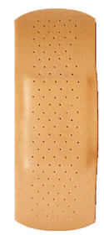
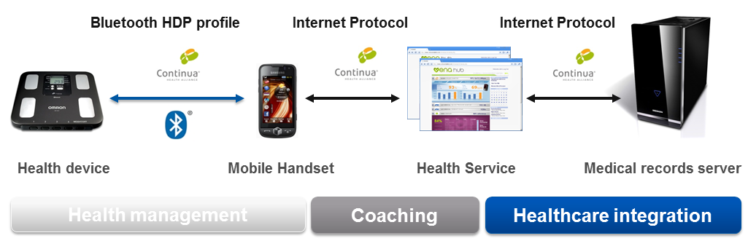
Product Hierarchy

Slide 5
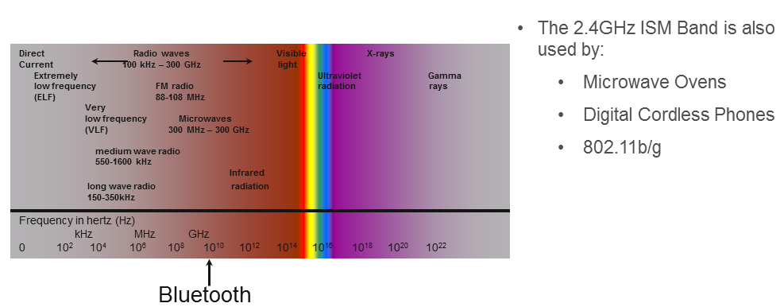
Bluetooth Low Energy

Slide 6
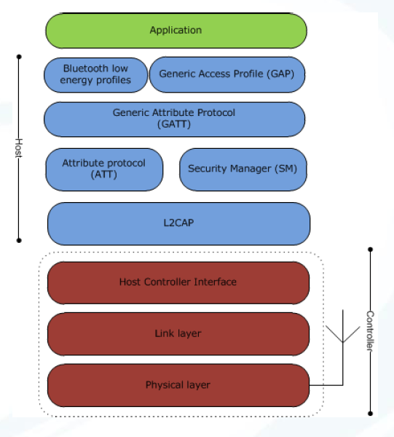
Architecture
L2CAP
Segmentation and reassembly of packets
ATT
Ability to read/write attribute values
GATT
Grouping of attributes

Slide 7
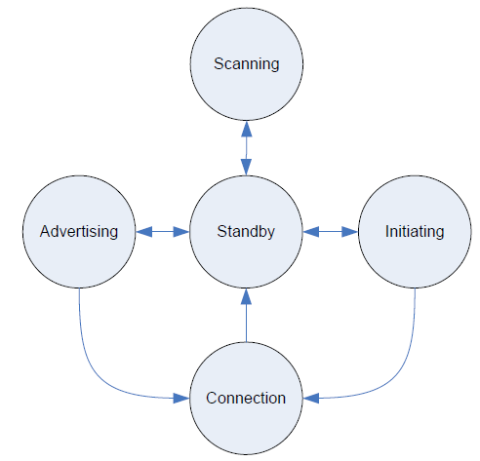
Link Layer State Machine
The Link Layer state machine allows only one state to be active at a time.
The Link Layer shall have at least one Link Layer state machine that supports one of Advertising State or Scanning State.
The Link Layer may have multiple instances of the Link Layer state machine.
Certain combinations of states and roles within multiple state machines in the Link Layer are prohibited.

Slide 8
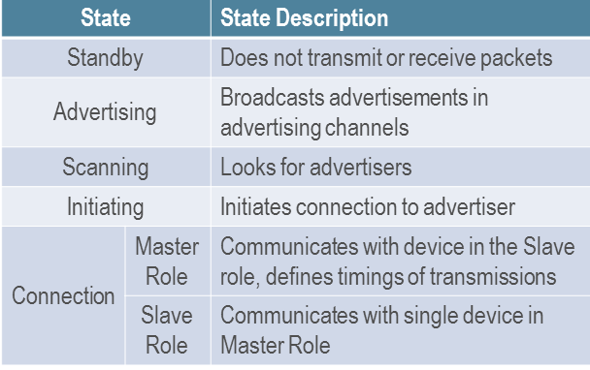
Operating States and Roles

Slide 9
Link Layer States
Standby State does not transmit or receive any packets.
Can be entered from any other state.
Advertising State will be transmitting advertising channel packets and possibly listening to and responding to responses triggered by these advertising channel packets.
A device in the Advertising State is known as an advertiser.
Can be entered from the Standby State.
Scanning State will be listening for advertising channel packets from devices that are advertising.
A device in the Scanning State is known as a scanner.
can be entered from the Standby State.
Initiating State will be listening for advertising channel packets from a specific device(s) and responding to these packets to initiate a connection with another device.
Initiating State is known as an initiator.
can be entered from the Standby State.
The Connection State can be entered either from the Initiating State or the Advertising State.
A device in the Connection State is known as being in a connection.

Slide 10
Two roles in the connection State
If it does support multiple state machines, the following state and role restrictions shall apply
The Link Layer in the Connection State shall not operate in the Master Role and Slave Role at the same time.
Master Role
When entered from the Initiating State, the Connection State shall be in the Master Role.
The Link Layer in the Master Role will communicate with a device in the Slave Role and defines the timings of transmissions.
May have multiple connections.
Slave Role
When entered from the Advertising State, the Connection State shall be in the Slave Role.
The Link Layer in the Slave Role will communicate with a single device in the Master Role.
shall have only one connection.
The Link Layer may optionally support multiple state machines.

Slide 11
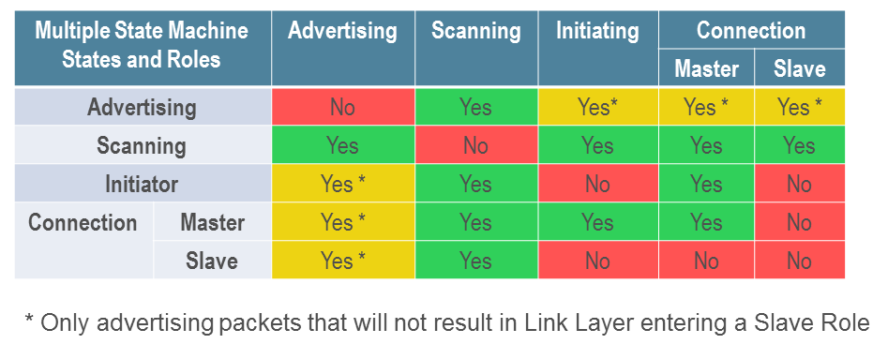
Link Layer state machine state combinations

Slide 12
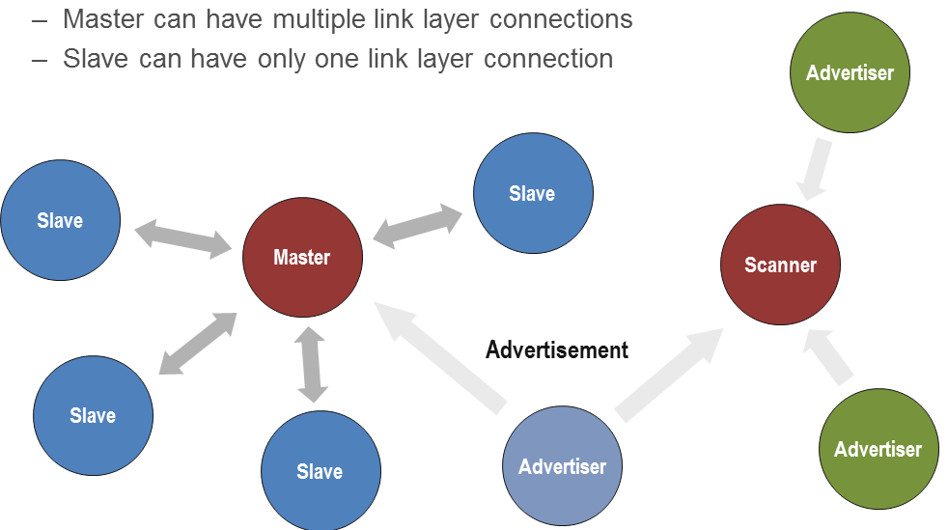
Star Topology

Slide 13
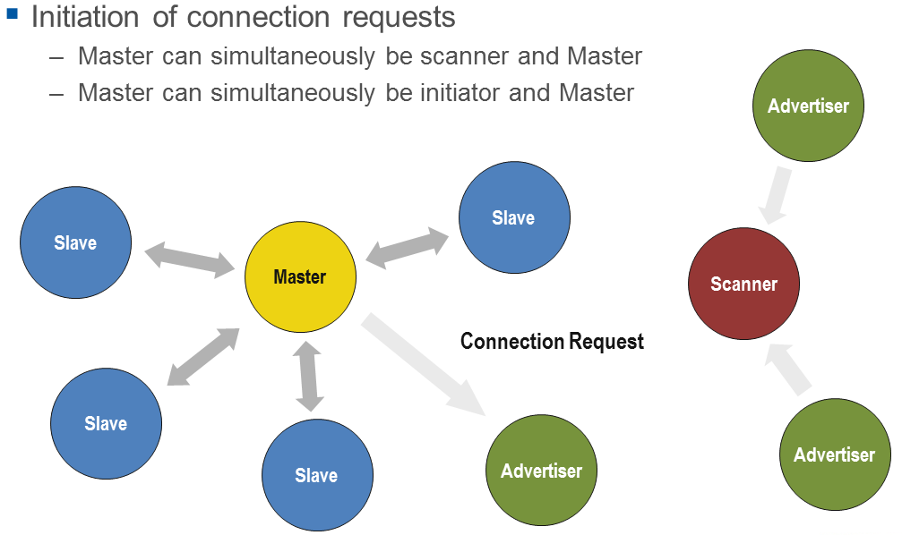

Slide 14
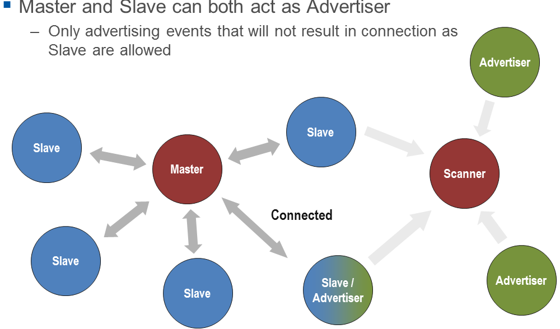

Slide 15
Device address
Devices are identified using a device address.
Device addresses may be either a public device address or a random device address.
A device shall contain at least one type of device address and may contain both.
A public device address and a random device address are both 48 bits in length.
company_assigned field is contained in the 24 least significant bits
company_id field is contained in the 24 most significant bits
The public device address shall be created in accordance with section 9.2 ("48-bit universal LAN MAC addresses") of the IEEE 802-2001 standard.
The random device address is divided into the following two fields:
hash field is contained in the 24 least significant bits
random field is contained in the 24 most significant bits

Slide 16
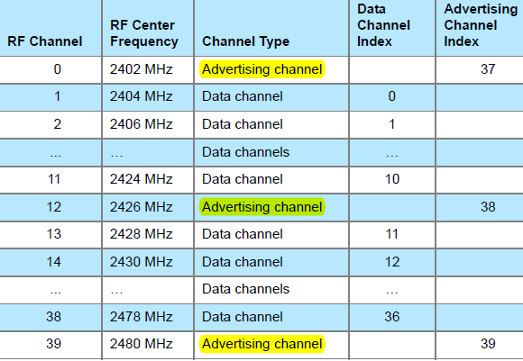
Advertising and Data Channel Indexes

Slide 17
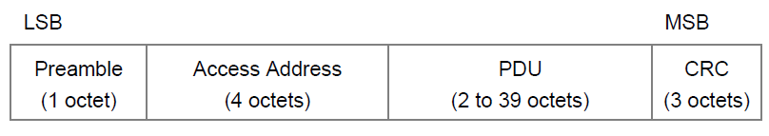
AIR INTERFACE PACKETS
The Link Layer has only one packet format used for both advertising channel packets and data channel packets.
Each packet consists of four fields:
the preamble, the Access Address, the PDU, and the CRC.
The shortest packet is 80 bits in length.
The longest packet is 376 bits in length.
preamble 1 byte
The Advertising channel packets shall have 10101010b
The data channel packet preamble is either 10101010b or 01010101b, depending on the LSB of the Access Address

Slide 18
Access Address
The Access Address for all advertising channel packets shall be 10001110100010011011111011010110b (0x8E89BED6).
This is NOT device address.
The Access Address in data channel packets shall be different for each Link Layer connection between any two devices with certain restrictions as defined below.
The Access Address shall be a random 32-bit value, generated by the device in the Initiating State and sent in a connection request as defined in Section 2.3.3.1.
The initiator shall ensure that the Access Address meets the following requirements:
It shall have no more than six consecutive zeros or ones.
It shall have a minimum of two transitions in the most significant six bits.
Detailed are not all included.

Slide 19
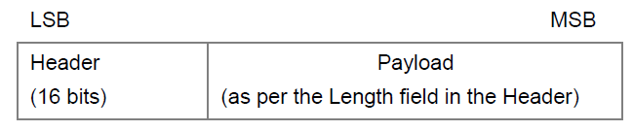
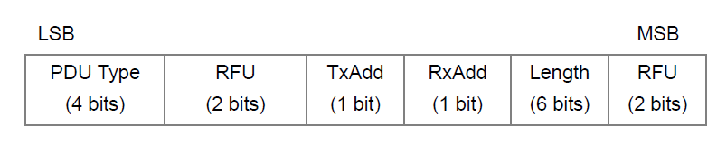
ADVERTISING CHANNEL PDU
The advertising channel PDU has a 16-bit header and a variable size payload.
Its format is as shown in
The 16 bit Header field of the advertising channel PDU is as shown in

Slide 20
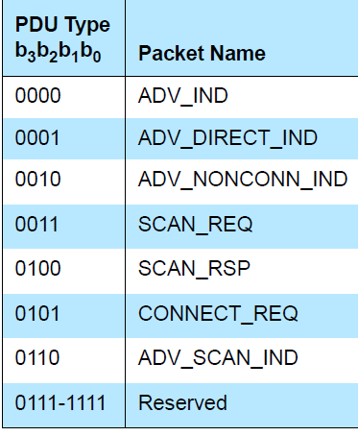
Advertising channel PDU Header’s
The following advertising channel PDU Types are called advertising PDUs and are used in the specified events:
ADV_IND: connectable undirected advertising event
ADV_DIRECT_IND: connectable directed advertising event
ADV_NONCONN_IND: non-connectable undirected advertising event
ADV_SCAN_IND: scannable undirected advertising event
These PDUs are sent by the Link Layer in the Advertising State and received by a Link Layer in the Scanning State or Initiating State

Slide 21
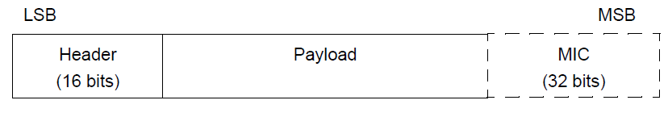
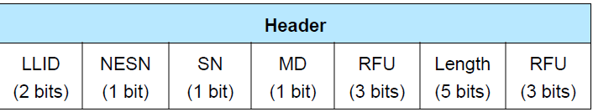
Data Channel PDU
16 bit header, a variable size payload, and may include a Message Integrity Check (MIC) field.

Slide 22
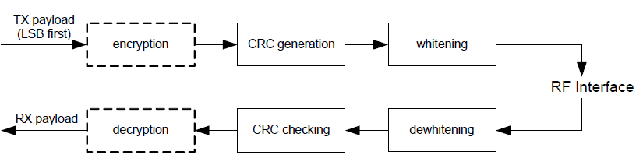
BIT STREAM PROCESSING
Bluetooth devices shall use the bitstream processing schemes as defined in the following
Payload bit processes

Slide 23
LINK LAYER DEVICE FILTERING
The Link Layer may perform device filtering based on the device address of the peer device.
Link Layer Device Filtering is used by the Link Layer to minimize the number of devices to which it responds.
The filter policies for the Advertising State, Scanning State and Initiating State are independent of each other.
When the Link Layer is in the Advertising State, the advertising filter policy shall be used.
When the Link Layer is in the Scanning State, the scanning filter policy shall be used.
When the Link Layer is in the Initiating State, the initiator filter policy shall be used.
If the Link Layer does not support the Advertising State, Scanning State, or Initiating State, the corresponding filter policy is not required to be supported.

Slide 24
White List
The set of devices that the Link Layer uses for device filtering is called the White List.
A White List contains a set of White List Records used for Link Layer Device Filtering.
A White List Record contains both the device address and the device address type (public or random).
All Link Layers supporting Link Layer Device Filtering shall support a White List capable of storing at least one White List Record.
On reset, the White List shall be empty.
The White List is configured by the Host and is used by the Link Layer to filter advertisers, scanners or initiators.
This allows the Host to configure the Link Layer to act on a request without awakening the Host.
All the device filter policies shall use the same White List.

Slide 25
Standby State
The Standby State is the default state in the Link Layer.
The Link Layer shall not send or receive packets in the Standby State.
The Link Layer may leave the Standby State to enter the Advertising State, Scanning State or Initiator State.

Slide 26
Advertising State
The Link Layer shall enter the Advertising State when directed by the Host.
When placed in the Advertising State, the Link Layer shall send advertising PDUs in advertising events.
Each advertising event is composed of one or more advertising PDUs sent on used advertising channel indexes.
The advertising event shall be closed after one advertising PDU has been sent on each of the used advertising channel Indexes
or the advertiser may close an advertising event earlier to accommodate other functionality.

Slide 27
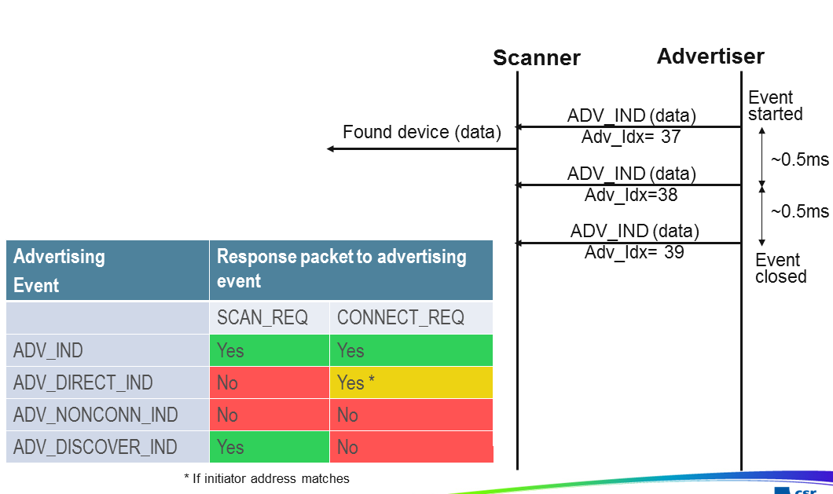
Advertising

Slide 28
OVERVIEW OF BLUETOOTH LOW ENERGY OPERATION
Devices that transmit advertising packets on the advertising PHY channels are referred to as advertisers.
Devices that receive advertising on the advertising channels without the intention to connect to the advertising device are referred to as scanners.
Devices that need to form a connection to another device listen for connectable advertising packets. Such devices are referred to as initiators.
If the advertiser is using a connectable advertising event, an initiator may make a connection
request using the same advertising PHY channel on which it received the connectable
advertising packet.
The advertising event is ended and connection events begin if the advertiser receives and accepts the request for a connection be initiated.
Once a connection is established, the initiator becomes the master device in what is referred to as a piconet and the advertising device becomes the slave device.
Connection events are used to send data packets between the master and slave devices.
In connection events, channel hopping occurs at the start of each connection event.
Within a connection event, the master and slave alternate sending data packets using the same data PHY channel.
The master initiates the beginning of each connection event and can end each connection event at any time.

Slide 29
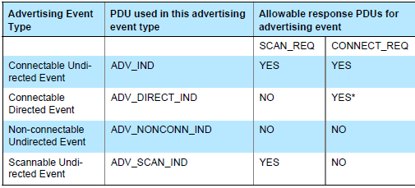
advertising event type
a connectable undirected event
a connectable directed event
a non-connectable undirected event
a scannable undirected event

Slide 30
Scanning State
The Link Layer shall enter the Scanning State when directed by the Host.
When scanning, the Link Layer shall listen on the advertising channel indices.
There are two types of scanning, determined by the Host: passive and active.
There are no strict timing or advertising channel index selection rules for scanning.

Slide 31
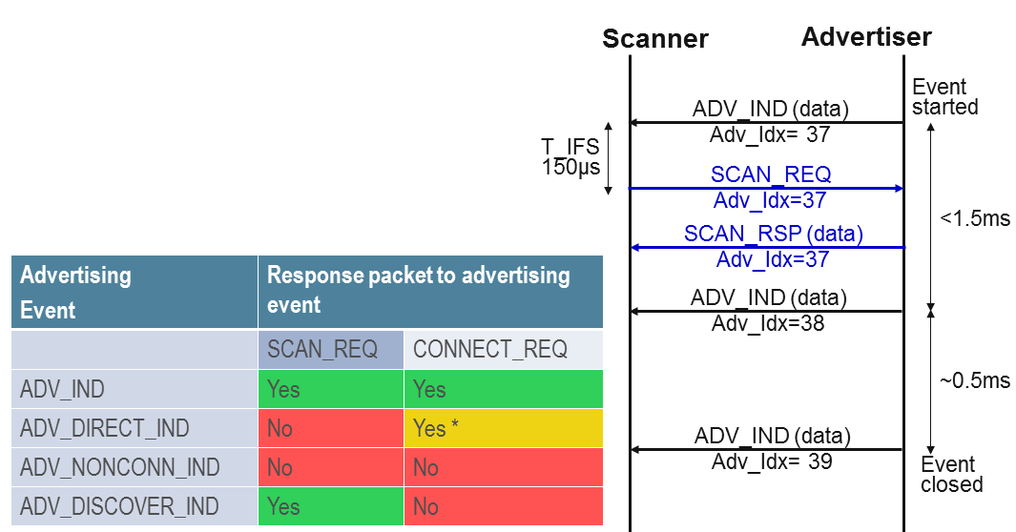
Active Scanning

Slide 32
Initiating State
The Link Layer shall enter the Initiating State when directed by the Host.
When initiating, the Link Layer shall listen on the advertising channel indices.
There are no strict timing or advertising channel index selection rules for initiators.
During initiating, the Link Layer listens on an advertising channel index for the
duration of the scan window, scanWindow.
The scan interval, scanInterval, is defined as the interval between the start of two consecutive scan windows.
The Link Layer should listen for the complete scanWindow every scanInterval as directed by the Host unless there is a scheduling conflict.
In each scan window, the Link Layer should listen on a different advertising channel index.
The Link Layer shall use all the advertising channel indexes.
After sending the CONNECT_REQ PDU, the Link Layer shall exit the Initiating State, and shall transition to the Connection State in the Master Role

Slide 33
CONNECTION STATE
The Link Layer enters the Connection State when an initiator sends a CONNECT_REQ PDU to an advertiser.
An advertiser receives a CONNECT_REQ PDU from an initiator.
After entering the Connection State, the connection is considered to be created.
The connection is not considered to be established at this point.
The connection is only considered to be established once a data channel packet has been received from the peer device.
The only difference between a created connection and a established connection is the Link Layer connection supervision timeout value that is used.
When two devices are in a connection, the two devices act in different roles.
A Link Layer in the Master Role is called a master. A Link Layer in the Slave Role is called a slave.
The master controls the timing of a connection event.
A connection event is a point of synchronization between the master and the slave.

Slide 34
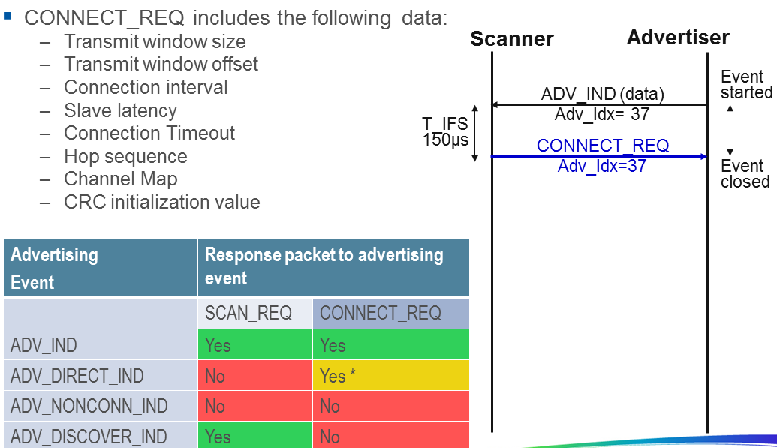

Slide 35
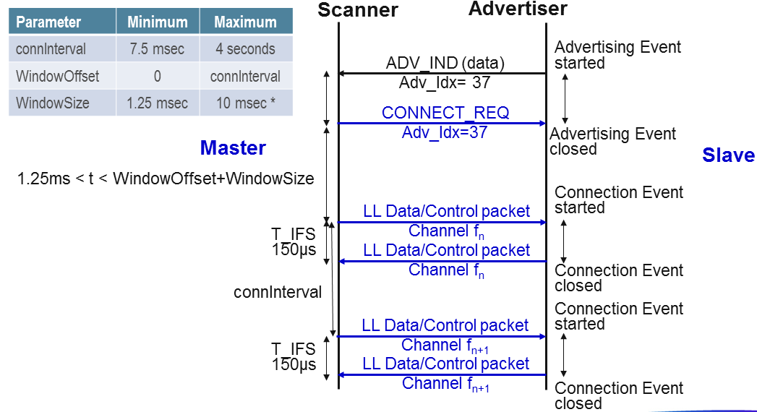

Slide 36
Connection Setup – Master Role
After the initiator sends the CONNECT_REQ PDU the Link Layer is in Connection State in the Master Role.
The master shall reset the Link Layer connection supervision timer TLLconnSupervision.
The Link Layer shall notify the Host that the connection has been created.
The first connection event shall use the data channel index as specified in Section 1.4.1.
The master shall start to send the first packet within the transmit window as defined in Section 4.5.3. It is permitted that the master’s first packet can extend beyond the transmit window.
The first packet sent in the Connection State by the master determines the anchor point for the first connection event, and therefore the timings of all future connection events in this connection.
The second connection event anchor point shall be connInterval after the first connection event anchor point.
All the normal connection event transmission rules specified in Section 4.5.1 shall apply.
Two examples of the LL connection setup procedure timing from master’s perspective are shown in Figure 4.11 and in Figure 4.12.

Slide 37
Connection Setup – Slave Role
After the advertiser receives a CONNECT_REQ PDU the Link Layer is in Connection State in the Slave Role.
The slave shall reset the Link Layer connection supervision timer TLLconnSupervision. The Link Layer shall notify the Host that the connection has been created.
The first connection event shall use the data channel index as specified in Section 1.4.1.
The slave shall start to listen for the first packet within the transmit window as defined in Section 4.5.3. It is permitted that the master’s first packet can extend beyond the transmit window, and therefore the slave must take this into account.
The first packet received, regardless of a valid CRC match (i.e., only the access code matches), in the Connection State by the slave determines the anchor point for the first connection event, and therefore the timings of all future connection events in this connection.
If a packet is not received in a transmit window, the slave shall attempt to receive a packet in a subsequent transmit window.
A subsequent transmit window shall start connInterval after the start of the previous transmit window, with the same transmitWindowSize.
The data channel index shall be the next data channel index as specified in Section 1.4.1. The connEventCount shall also be incremented by one.

Slide 38
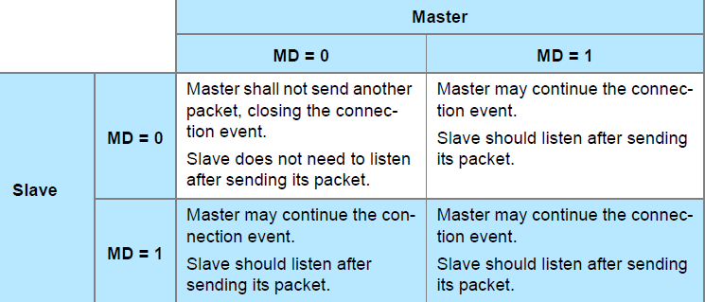
Closing Connection Events
The MD bit of the Header of the Data Channel PDU is used to indicate that the device has more data to send.
If neither device has set the MD bit in their packets, the packet from the slave closes the connection event.
If either or both of the devices have set the MD bit, the master may continue the connection event by sending another packet, and the slave should listen after sending its packet.
If a packet is not received from the slave by the master, the master will close the connection event.
If a packet is not received from the master by the slave, the slave will close the connection event.
Two consecutive packets received with an invalid CRC match within a connection event shall close the event.

Slide 39
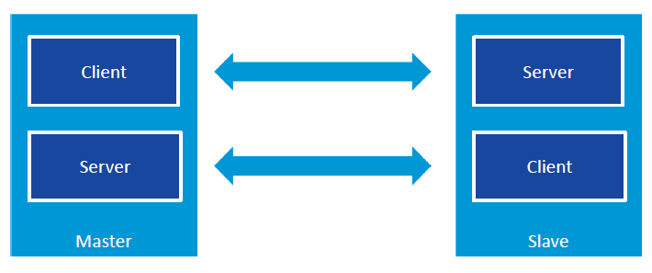
ATT Layer Overview
Link Layer Connection Role : Master , Slave
Attribute Arch : Client , Server

Slide 40
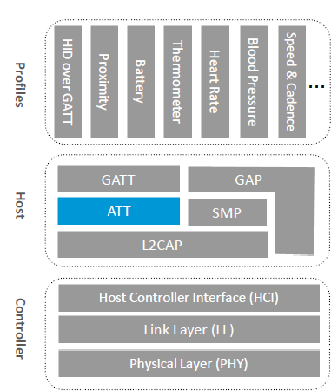
Attribute Protocol Overview
Mandatory and used for all data transfers in BLE
Fast, simple
Client – Server architecture
Server stores data
Client requests data
clients writes data to server
Server initiates Notifications and Indications
Supports for fine-grained security

Slide 41
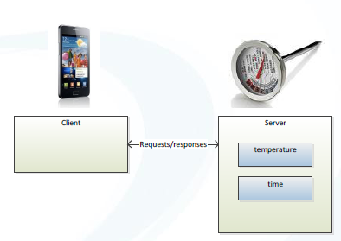
Attribute Protocol (ATT)
The only protocol used in Bluetooth low energy
Uses client server architecture
servers store data
clients request data from server
clients writes data to server
Protocol Methods
Client to server: Read, write
Server to client: Notify, indicate

Slide 42
ATT 4 Fields
Handle
Index in the ATT Table, used in ATT transaction PDU
The Attributes are ordered by increasing Attribute Handle values.
Attribute Handle values may begin at any value between 0x0001 and 0xFFFF.
Although the Attribute Handle values are in increasing order, following Attribute Handle values may differ by more than one. That is to say there may be gaps between successive Attribute Handles.
UUID – Universal Unique Identifier
128-bit UUID
16-bit short UUID using Bluetooth Base 0000XXXX-0000-1000-8000-00805F9B34FB
Permissions – Read, Write.
It is used by the server to determine whether read or write access is permitted for a given attribute.
Attribute Permissions are established by the GATT profile, a higher layer profile or are implementation specific if not specified.
Value – data can be read/written by Client

Slide 43
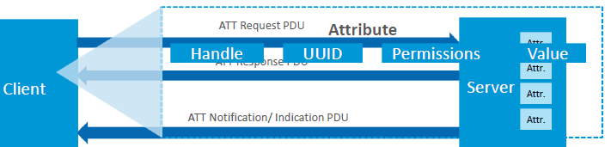
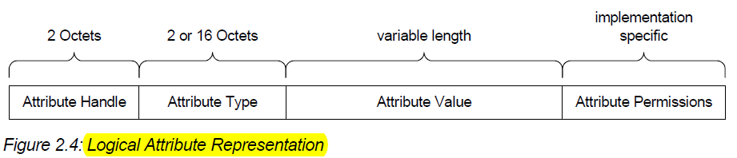
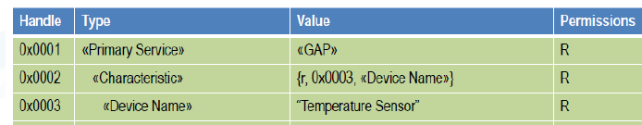

Slide 44
Attribute Operation
Attribute operations: read
Client requests data when it needs it
Client polls server for attribute value
This may be inefficient if data doesn’t change often
Shouldn’t be used for frequently changing data that you are monitoring
Attribute operations: write
Client can set attributes to configure a server
E.g. set the room temperature to 22ºC

Slide 45
Attribute operations: notify
Server sends the data when it changes
Attribute operations: indicate
Server sends the data when it changes
Client confirms that is has received the data

Slide 46
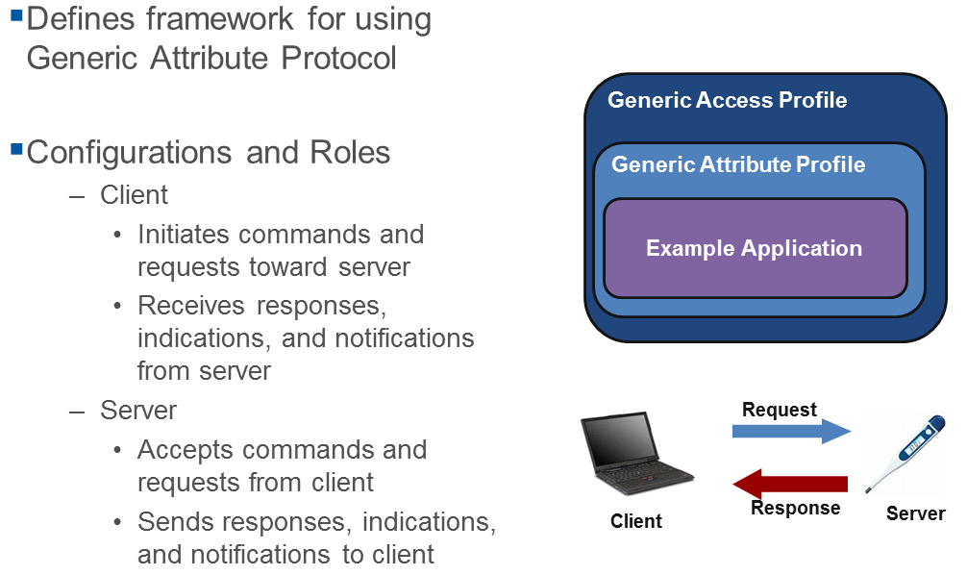
Generic Attribute Profile GATT

Slide 47
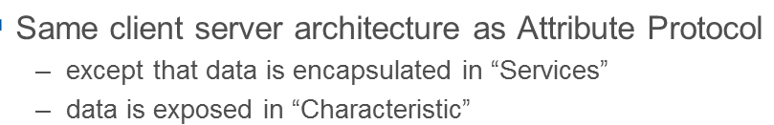
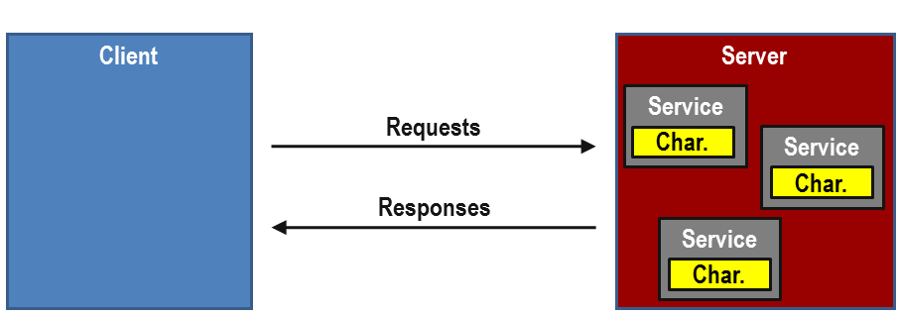
GATT Client Server Architecture

Slide 48
GATT Definition
service : is a collection of data and associated behaviors to accomplish a particular function or feature
Primary service : that exposes the primary usable functionality of this device. A primary service can be included by another service. Primary services can be discovered using Primary Service Discovery procedures.
Secondary service : a service that is only intended to be referenced from a primary service or another secondary service or other higher layer specification
Included service
An included service is a method to reference another service definition existing on the server into the service being defined
When a service definition uses an include definition to reference the included service, the entire included service definition becomes part of the new service definition
Characteristic
contains a characteristic declaration, characteristic properties, and a value
and may contain descriptors that describe the value or permit configuration of the server with respect to the characteristic.

Slide 49
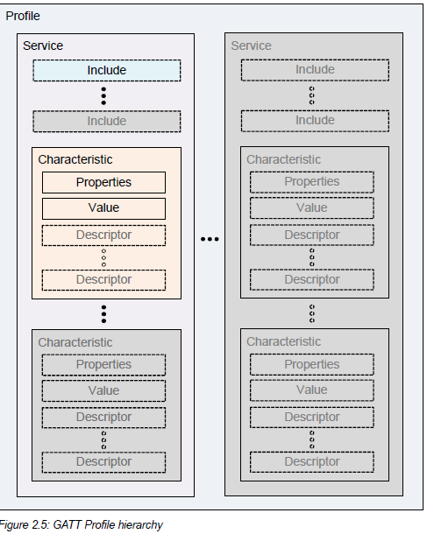

Slide 50
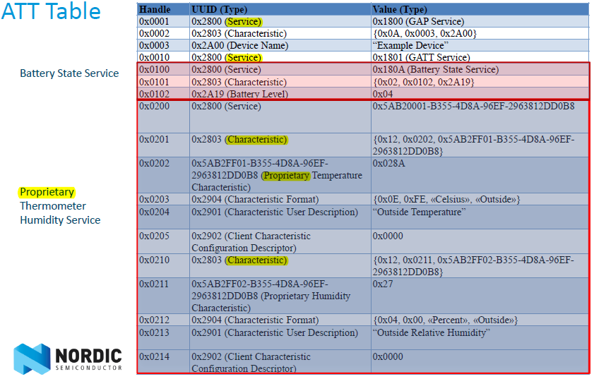

Slide 51
Generic Access Profile GAP
Define Profile Roles
Broadcaster
Observer
Central
Peripheral
Define Procedures
Discovering identities, names, and basic capabilities
Creating bonds
Exchange of Security Information
Establish connections
Resolvable Private addresses
Define Advertising and Scan Response Data formats
All profiles are built upon GAP

Slide 52
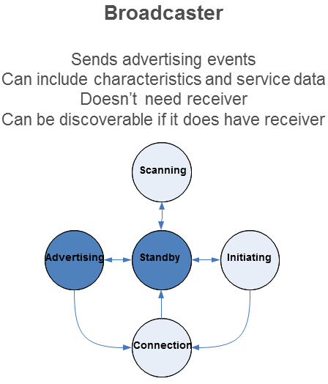
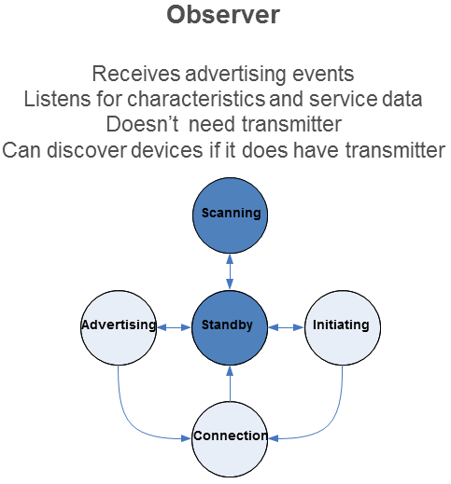
Profile Roles

Slide 53
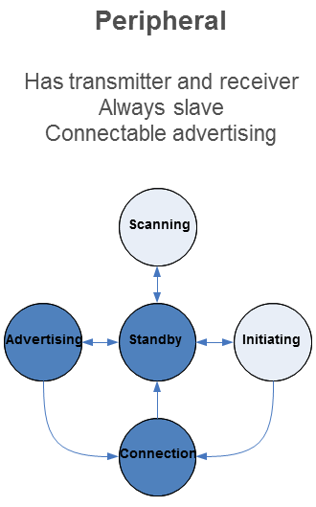
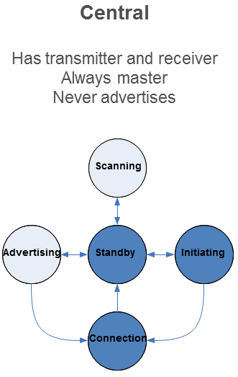

Slide 54
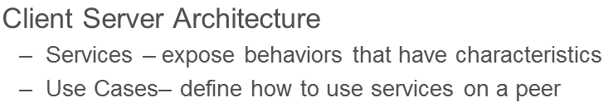
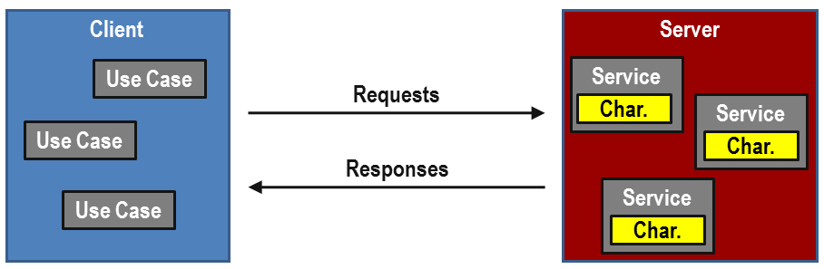
BTLE application

Slide 55
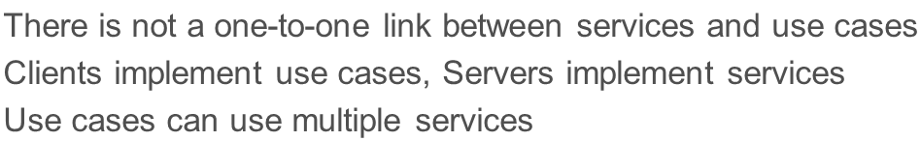
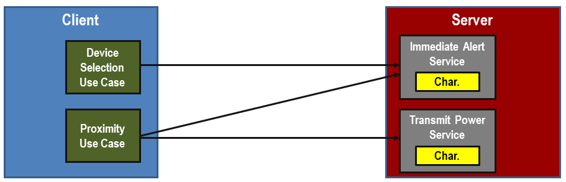
Use Cases and Services

Slide 56
Nordic nrf51822

Slide 57
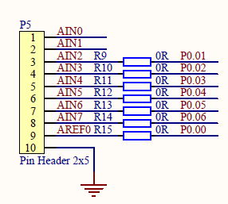
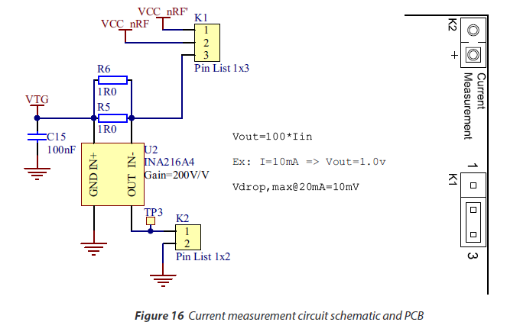
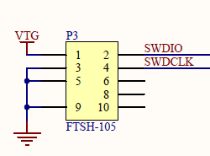
Power PCA1000x without nrfGo MB
The board can be powered by connecting VCC to pin 2 on K1, and connect the ground to the GND "pin" at P5/P3.

Slide 58
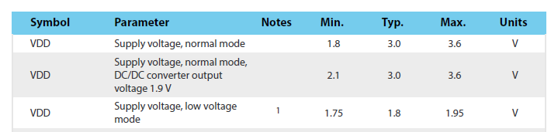

Slide 59
S110 softdevice
BluetoothR low energy (BLE) Peripheral protocol stack solution.
pre-compiled and linked binary software implementing a Bluetooth 4.0 low energy (BLE) protocol stack.
The S110 is compatible with selected nRF51 System on Chip (SoC) devices.
The API is a standard C language set of functions and data types that give the application complete compiler and linker independence from the SoftDevice implementation.
A SoftDevice enables the application programmer to develop their
code as a standard ARM Cortex™-M0 project without needing to integrate with proprietary chip-vendor software frameworks.
Any ARM Cortex™-M0 compatible toolchain can be used to develop Bluetooth low energy applications with the S110 SoftDevice.

Slide 60
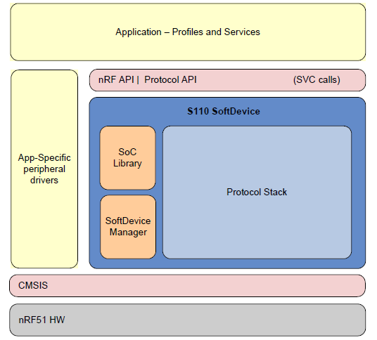

Slide 61
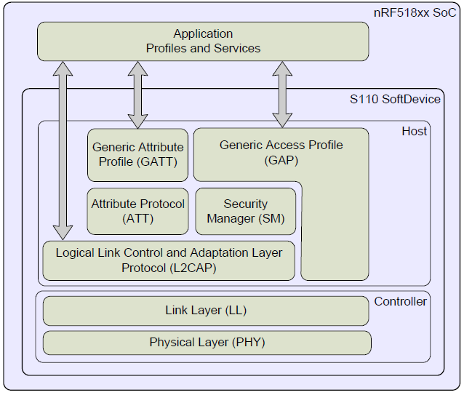
LE stack architecture

Slide 62
Bluetooth low energy features
GAP, GATT, SM, and L2CAP are implemented in the SoftDevice and managed through the API.
GAP and GATT procedures and modes that are common to most profiles, such as the handling of discoverability, connectability, pairing, and bonding,
are implemented in the stack.
The BLE API is consistent across Bluetooth role implementations where features in common have the same
interface. In the following sections, the features of the BLE stack in the S110 SoftDevice are identified.

Slide 63
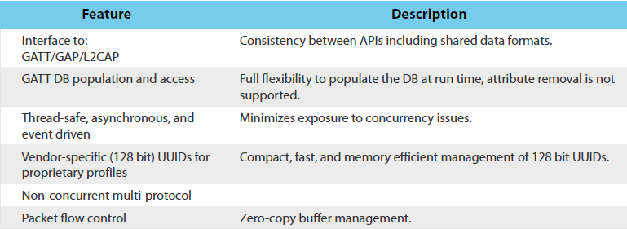
API

Slide 64


Slide 65


Slide 66

Hardware blocks and interrupt vectors

Slide 67


Slide 68


Slide 69
MPU6050/9150
https://github.com/jrowberg/i2cdevlib/tree/master/Arduino
Nordic SDK
c:\Nordic Semiconductor\nRF51 SDK_v4.2.0.25053\Nordic\nrf51822\Source\ext_sensors\mpu6050\

Slide 70


Slide 71


Slide 72

9-axis Sensor Fusion Using I2C Interface

